Slide 1

Cracking a WEP Encryption Network
Presented by:
Chris Nnaji Geovanni Herrera Esfandiar Behrouz
Notes:
Slide 1 - Cover Slide: This is the cover slide, with the presentation title and team members presenting.
This presentation is called "DHCP Starvation Attack with Yersinia,"

Slide 2
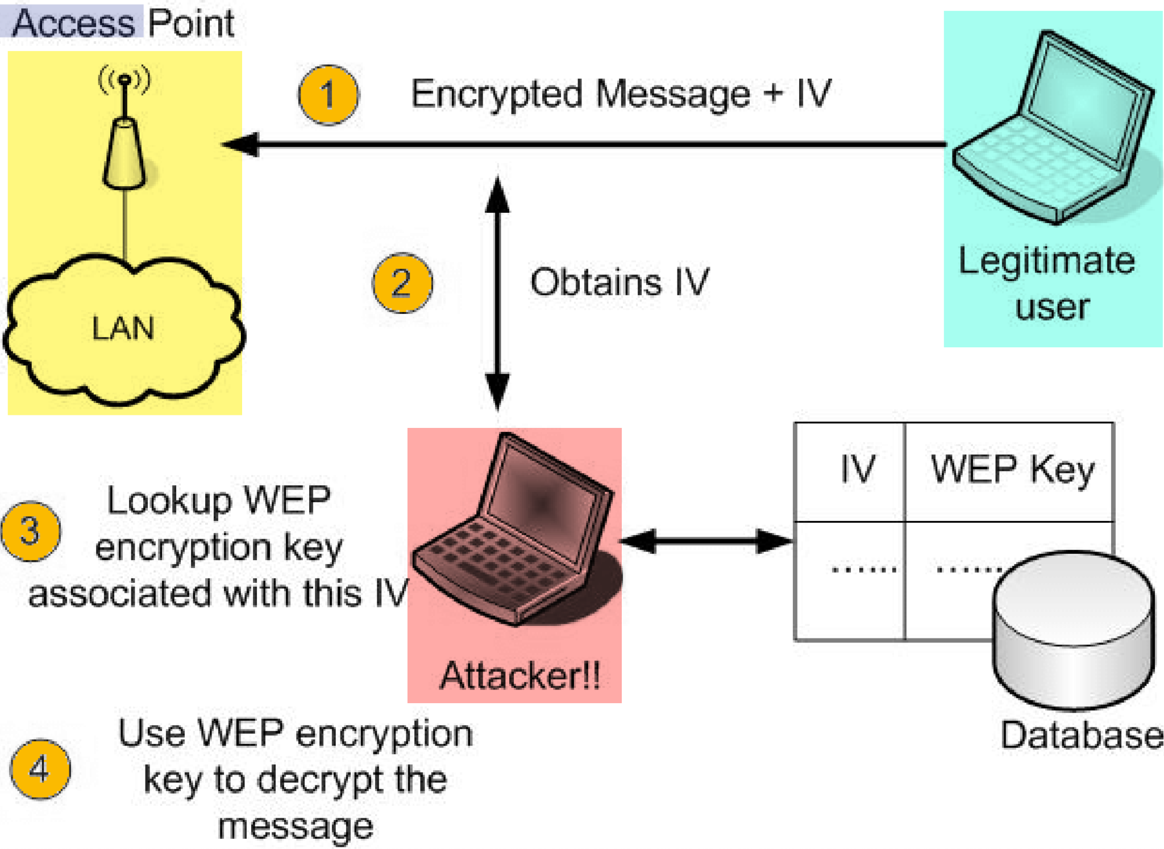
What is WEP?
Wired Equivalent Privacy (WEP) is a security Protocol part of 802.11b standard that provides Wireless Local area Network (WLAN) with a level of security and privacy.
*
* Ref: IEEE 802.11 Wireless LAN Security Overview. ResearchGate
Notes:
Slide 2, 3, 4 - Technical Background: These slides explain the technical background of the project. They cover any protocols, cryptographic concepts, or network diagrams that are used in the upcoming demonstration.
Additionally, this section of the presentation can include:
Why you selected the topic that you are presenting.
Steps you took to research this topic.
For example, this presentation covers what the protocol DHCP is, what the attack is, DHCP starvation, and a network diagram, as the following image shows:

Slide 3

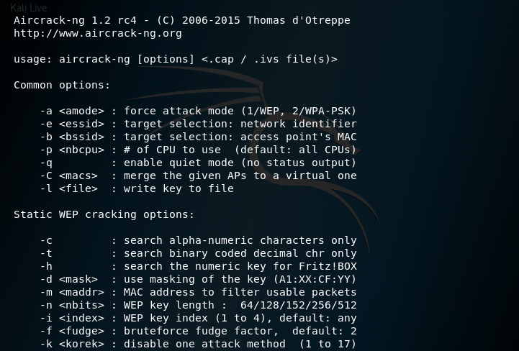
Aircrack-ng Attack
Aircrack-ng is a program used to crack WEP/WPA encryption. Able to capture 40-512 bit encryption.
Notes:
Slide 2, 3, 4 - Technical Background: These slides explain the technical background of the project. They cover any protocols, cryptographic concepts, or network diagrams that are used in the upcoming demonstration.
Additionally, this section of the presentation can include:
Why you selected the topic that you are presenting.
Steps you took to research this topic.
For example, this presentation covers what the protocol DHCP is, what the attack is, DHCP starvation, and a network diagram, as the following image shows:

Slide 4

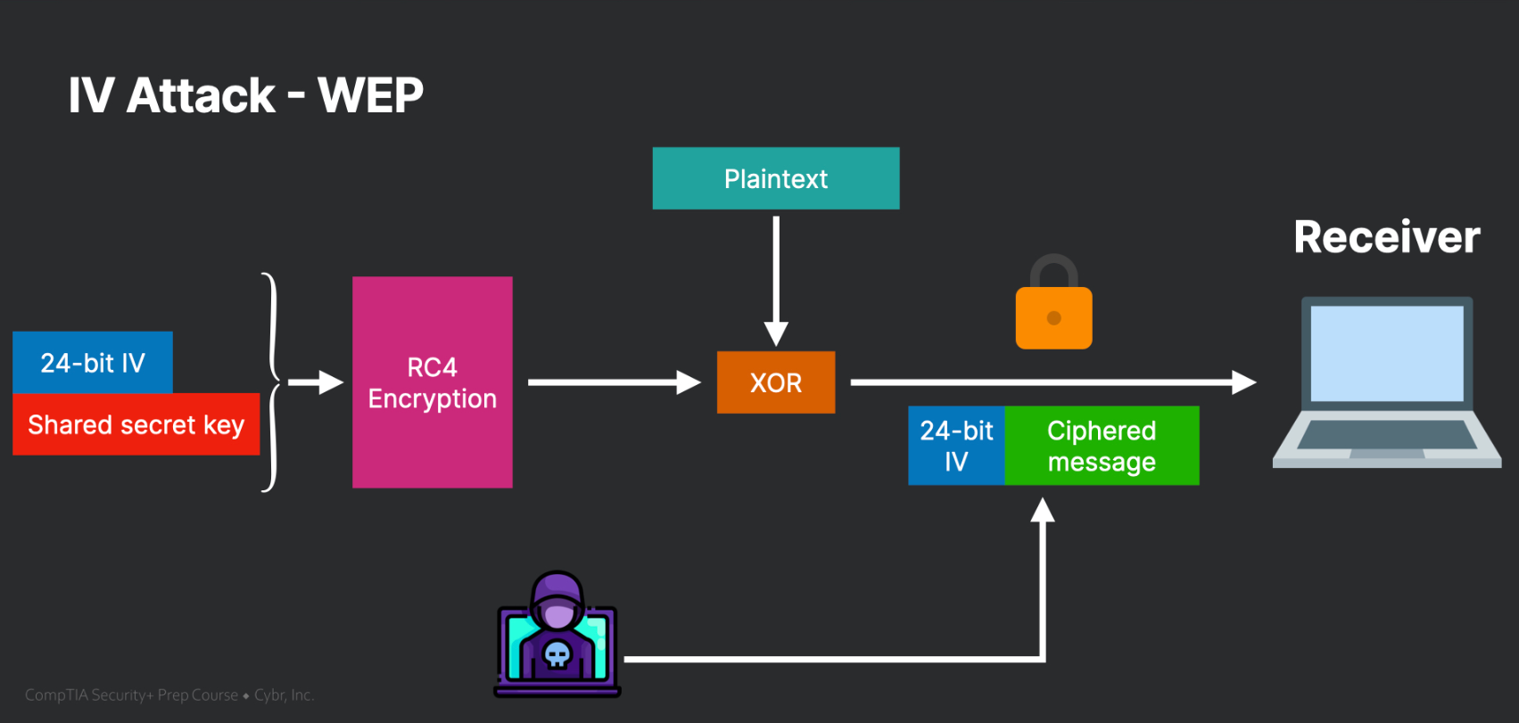
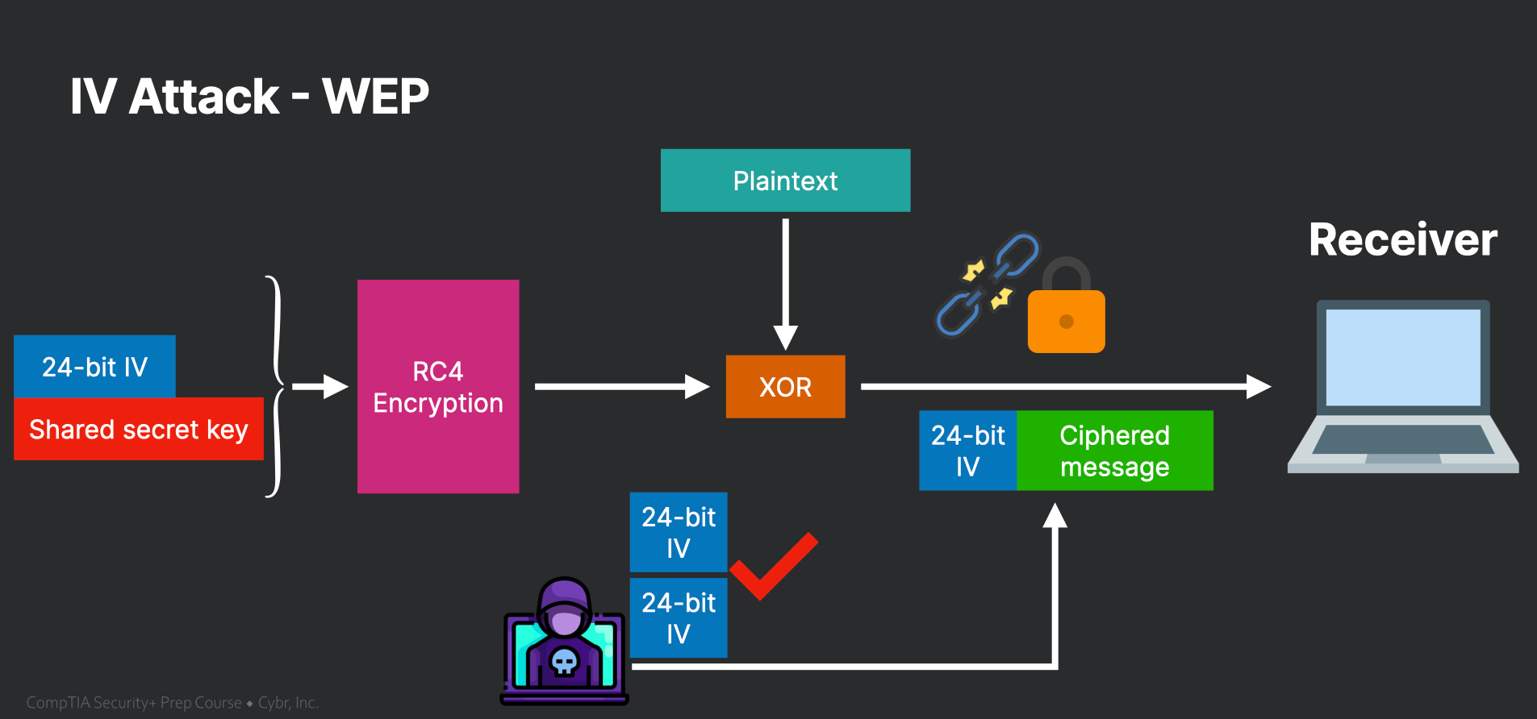
Visualization
*
* Ref: Initialization Vector (IV) attacks with WEP, Cybr.com
Notes:
Slide 2, 3, 4 - Technical Background: These slides explain the technical background of the project. They cover any protocols, cryptographic concepts, or network diagrams that are used in the upcoming demonstration.
Additionally, this section of the presentation can include:
Why you selected the topic that you are presenting.
Steps you took to research this topic.
For example, this presentation covers what the protocol DHCP is, what the attack is, DHCP starvation, and a network diagram, as the following image shows:

Slide 5

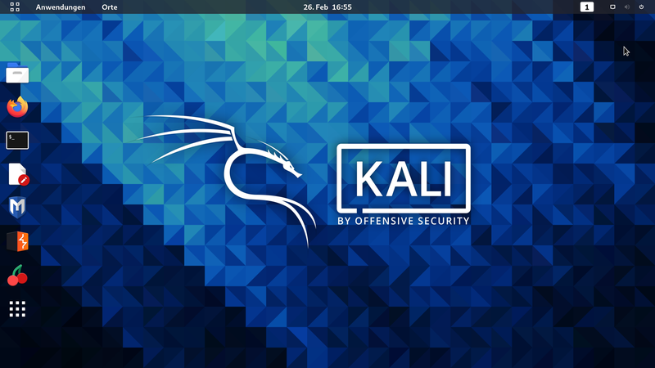
Tools and Packages used
Aircrack-ng
Airmon-ng
Airodump-ng
Special antenna
Notes:
Slide 5, 6 - Demonstration Preview: These slides cover the tool that you'll use to conduct the demonstration - basically, they preview the steps that you'll take in the upcoming demonstration.
This presentation shows how to install and set up Yersinia, and how it will be used to conduct the attack, as the following image shows:

Slide 6

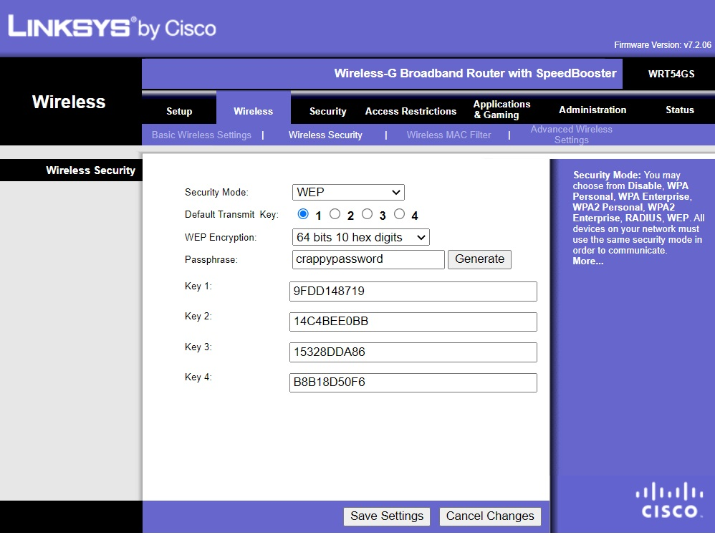
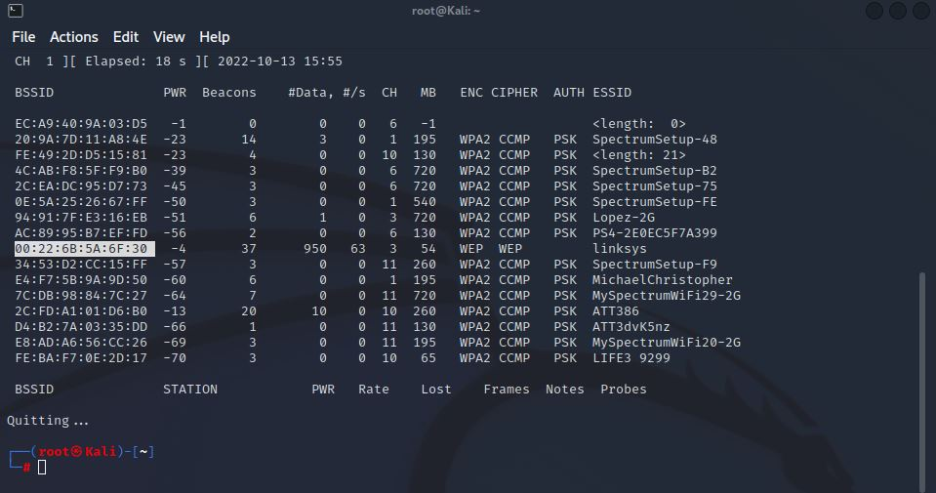
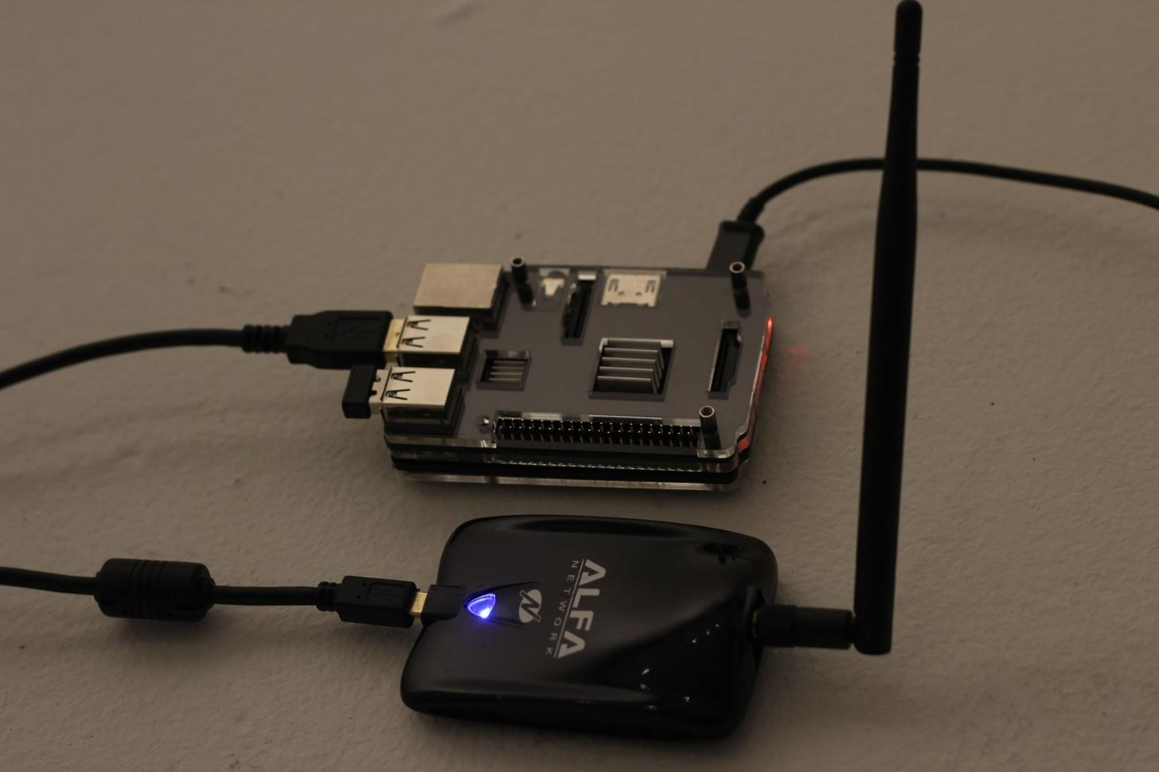
Demonstration Preview

Slide 7

WEP hack Demo

Slide 8

Effects of the Attack
Initialization Vector (IV) is only 24-bit long and although in theory it should be different per packet it will be eventually reused and identified.
The short IV and fixed key will allow a attacker to distinguish the key from the IV and decrypt the packets and eventually access the network.
When the attacker has access to the Wi-Fi network it will not be authenticated and identified as the key is reused and same for all users. From there sniffing traffic, scanning open ports, accessing other devices on the network will be a matter of time.

Slide 9
Mitigating Wireless Access Points
Depending on the capability and risk appetite of the business there will be several ways to mitigate this attack
Upgrading the security to more secure wireless protocols such as WPA2 or WPA3.
Check to see if updated WEP with stronger keys (128-bit) are available for the router
Change the key if there is any suspicion of an attack. Ideally install an Intruder Detection System (IDS) to monitor attacks.
At minimum, a sign should be posted at the business that the Wi-Fi network has low level of security, and is at user’s discretion.
Notes:
If your presentation does not involve an attack, then this slide is not required.

